Slide 1


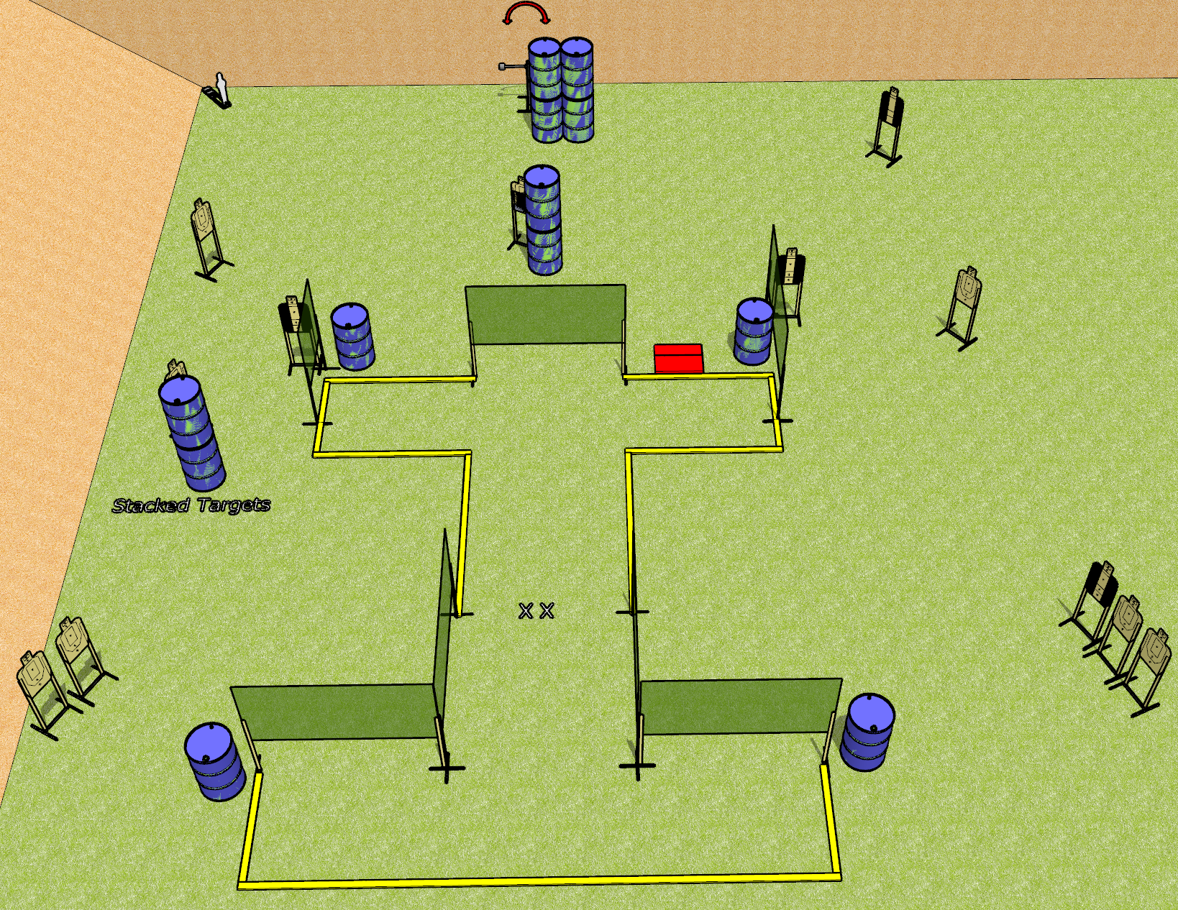
 | Dothan Gun Club – USPSA Match My Mags Are Where? Course Designer : Drew Coleman
Round Count 29 rounds 14 USPSA Targets 1 mini popper
Equipment List 12 wall feet Stomp box + 1 swinger 4 medium fault lines 4 tuxedos, 1 50%

Slide 2
My Mags Are Where?
Written Stage Briefing
My Mags Are Where? is a 29 round, 145 point, Comstock course of fire. There are 14 USPSA targets and 1 mini popper. The best 2 hits on paper will score, and steel must fall to score. The start signal is audible.
The swinger is activated by the stomp box and is visible at rest. Please check the activator prior to walkthrough and set it the same way every time.
Handgun start position is feet on X’s, wrists below belt. Handgun is UNLOADED and holstered.
PCC start position is feet on X’s. UNLOADED carbine is held with both hands.
All magazines to be used during the stage must come from barrels.
On start signal, engage targets as they become available from within the shooting area.

